Slide 1

GRAPH THEORY, APPLICATIONS AND COMBINATORICS
Dr. Arti Arya
Department of Computer Science & Engineering

Slide 2

GRAPH THEORY and Its APPLICATIONS
TREES
Dr. Arti Arya
Department of Computer Science & Engineering

Slide 3
Graph Theory and its Applications Disclaimer
The slides are prepared by Dr. Surabhi Narayan and a lot of inputs are added by Dr. Arti Arya. The sources of the information other than text book is mentioned wherever used.

Slide 4
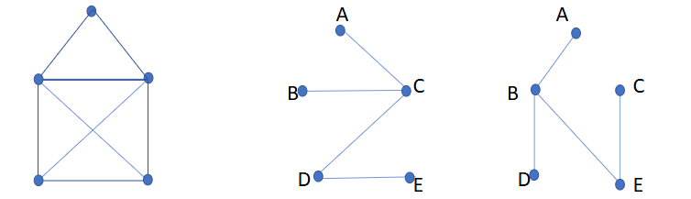
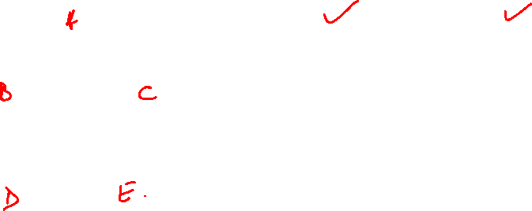
Graph Theory and its Applications
Spanning Trees
Spanning Tree:
A subgraph T of graph G is called a spanning tree of G if T is a tree and T contains all vertices of the graph G
Branch Set ={(AC, BC, CD, DE}, Chord Set={AB, BD, BE, CE}
Branch Set ={(AB, BD, CE, BE}, Chord Set={AC, BC, DC, DE}
Branch Set: Contains all the edges of the considered spanning tree.
Chord Set: all the edges that are not in the spanning tree
Fundamental Circuit: A circuit formed by adding a chord of G to a spanning tree T such that it creates only one circuit.

Slide 5
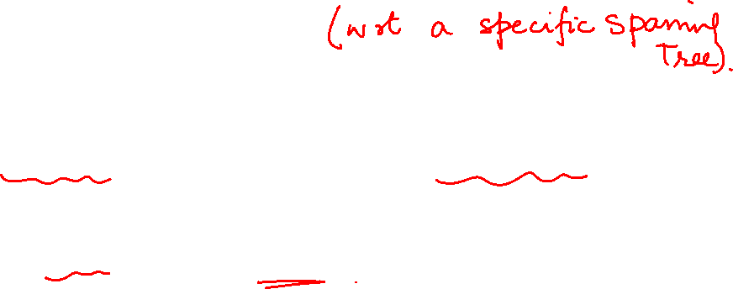
Graph Theory and its Applications
Spanning Trees
Generating all Spanning Trees of a Graph
Start from an arbitrary spanning tree.
Find the branch set and chord set.
3. Remove one edge from the chord set, add it to the spanning tree. Addition of
the chord creates exactly one fundamental circuit.
Remove any branch from the fundamental circuit.
Repeat steps 3,4 until chord set is empty.

Slide 6
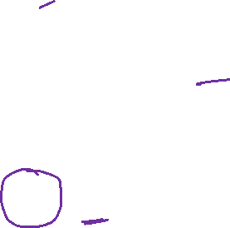
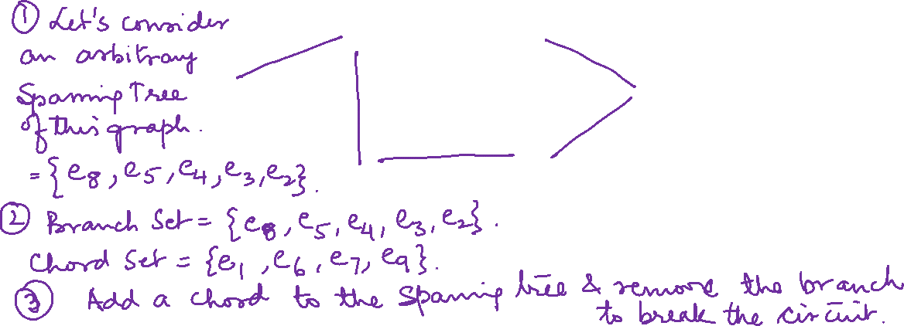
Graph Theory and Its Applications Spanning Trees
Find all spanning trees with respect to the spanning tree of the following graph G
e1
A
B
e2
e8
e7
F
e6
C
e5
e9
e3
E
D
e4

Slide 7
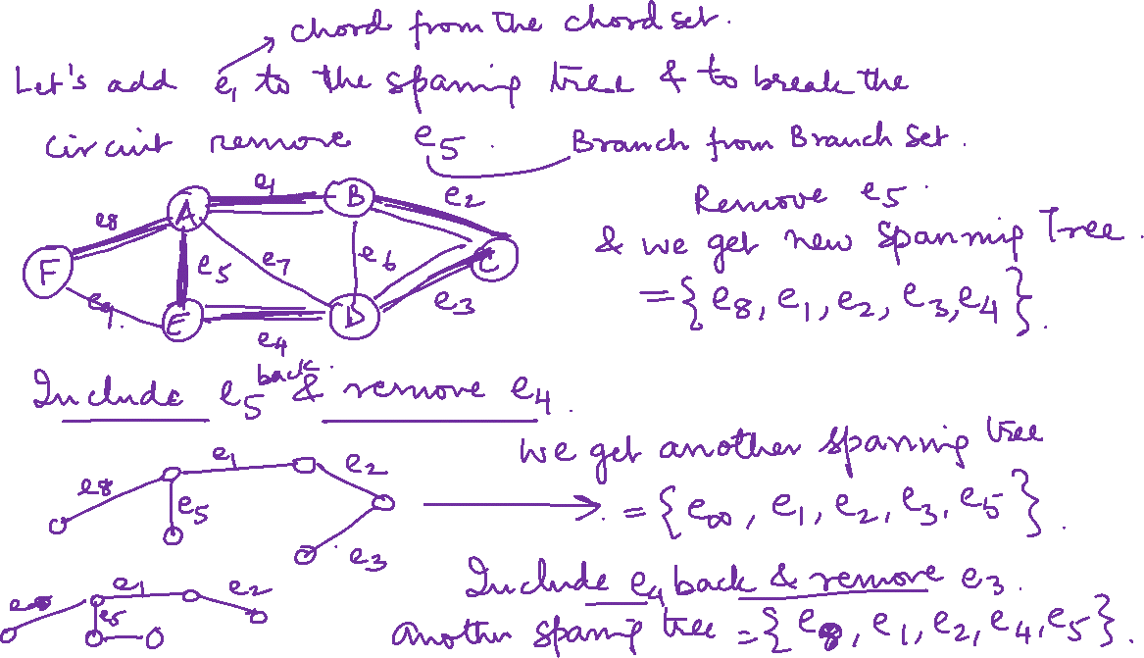

Slide 8
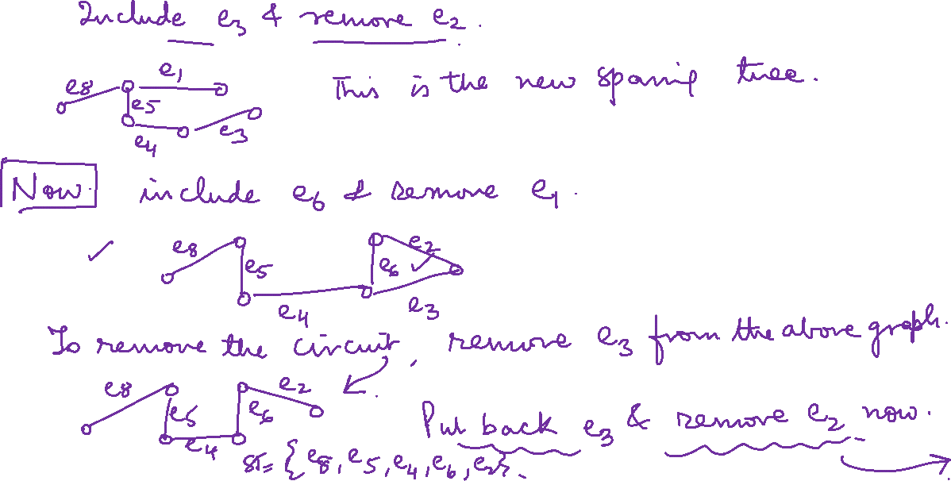

Slide 9
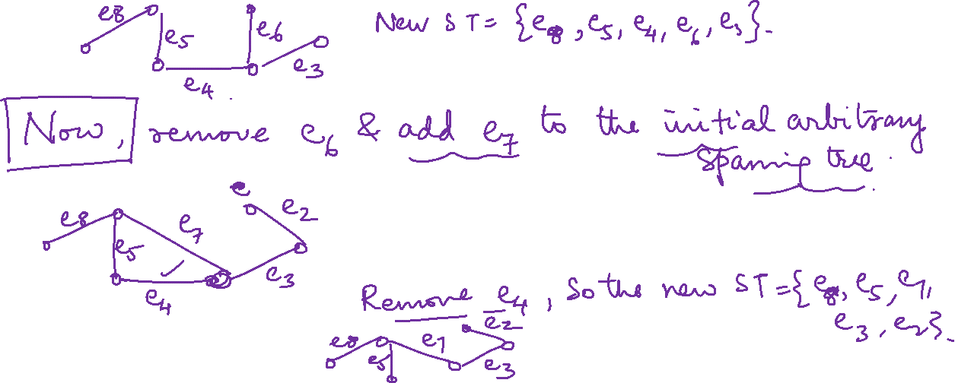

Slide 10
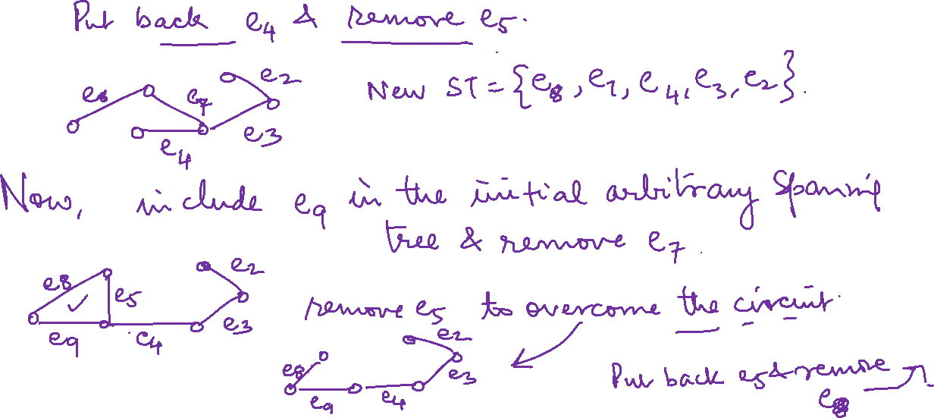

Slide 11
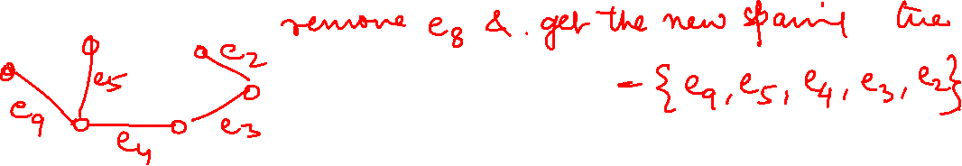

Slide 12
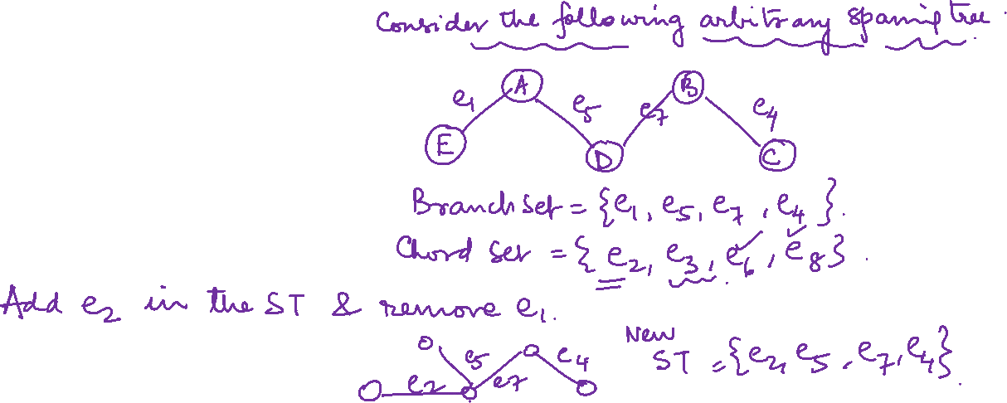
Graph Theory and its Applications Spanning Trees
Find all spanning trees with respect to a spanning tree of the following graph G
e3
A
B
e6
e1
e7
e4
e5
E
D
C
e2
e8

Slide 13
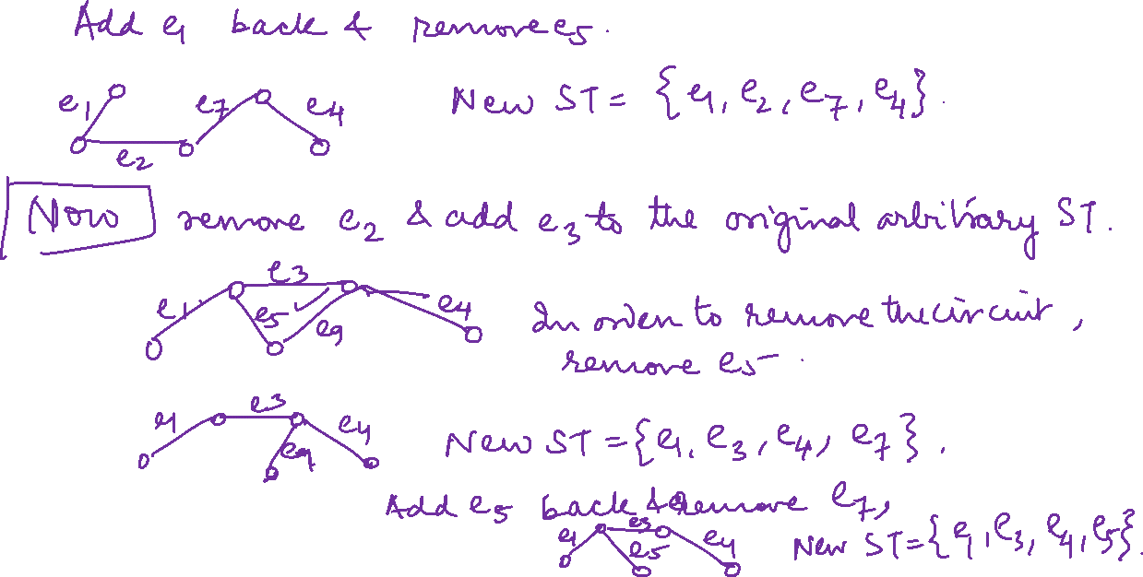

Slide 14
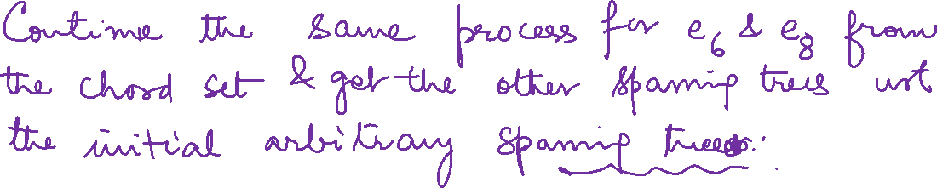

Slide 17

Graph Theory and its Applications Spanning Trees
Find all spanning trees with respect to a spanning tree of the following graph G
A
E
B
Let D-E-A-B-C be the spanning tree
Branch Set: {DE, EA, AB, BC}
Chord Set:{EB, CD, EC}
D
C

Slide 18
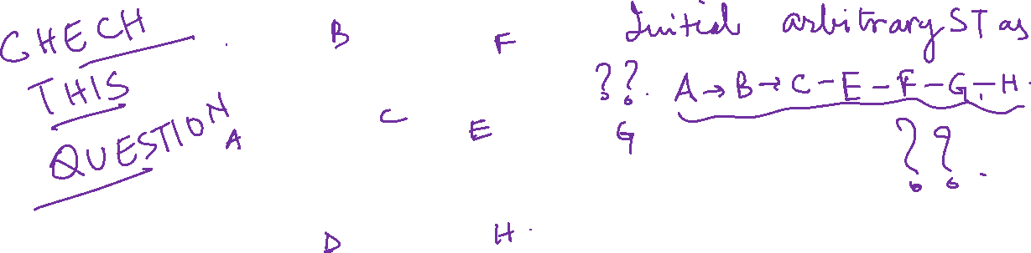
Graph Theory and its Applications
Spanning Trees
Find all spanning trees of the following graph G

Slide 19
Graph Theory and its Applications
Spanning Trees
Find all spanning trees of the following graph G

Slide 20
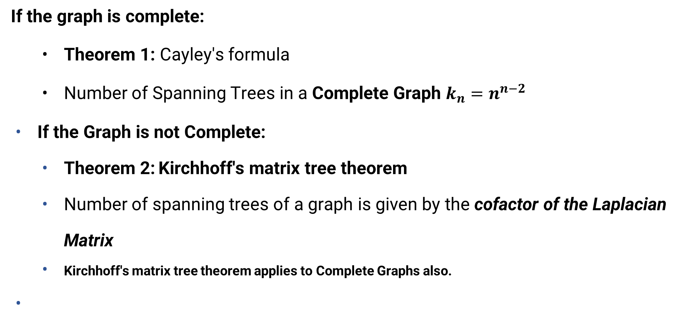
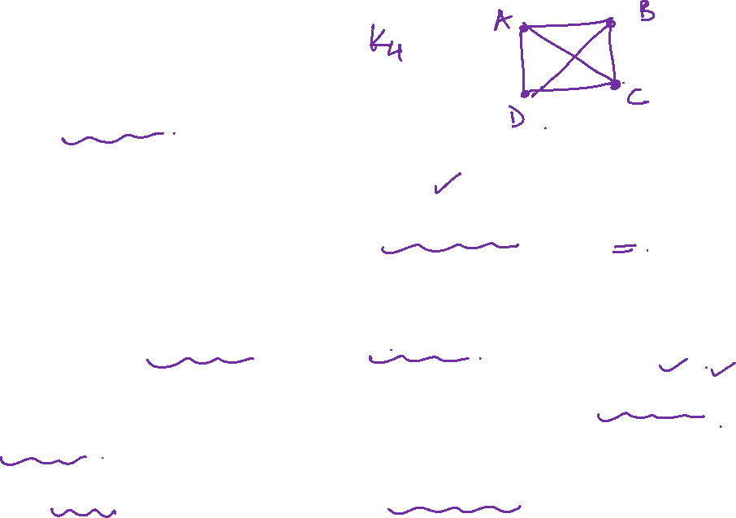
Graph Theory and its Applications
Spanning Trees
If the graph is complete:
Theorem 1: Cayley's formula
Number of Spanning Trees in a Complete Graph $k_{n}=n^{n−2}$
If the Graph is not Complete:
Theorem 2: Kirchhoff's matrix tree theorem
Number of spanning trees of a graph is given by the cofactor of the Laplacian Matrix
Kirchhoff's matrix tree theorem applies to Complete Graphs also.

Slide 21

Graph Theory and its Applications
Spanning Trees
Procedure to count the spanning trees using Kirchhoff’s matrix tree theorem STEP 1: Create Adjacency Matrix for the given graph. STEP 2: Replace all the diagonal elements with the degree of nodes.
STEP 3: Replace all non-diagonal 1’s with -1. STEP 4: Calculate co-factor for any element. STEP 5: The cofactor that you get is the total number of spanning tree for that graph.

Slide 22
Graph Theory and its Applications Spanning Trees
Cayley’s Formula: Number of Spanning Trees in a Complete Graph K_{n} = n^{(n-2)}
What if graph is not complete? ( Kirchoff’s Matrix Tree Theorem)
STEP 1: Create Adjacency Matrix for the given graph.
STEP 2: Replace all the diagonal elements with the degree of nodes. For eg. element at (1,1) position
of adjacency matrix will be replaced by the degree of node 1, element at (2,2) position of adjacency
matrix will be replaced by the degree of node 2, and so on. STEP 3: Replace all non-diagonal 1’s with -1.
STEP 4: Calculate co-factor for any element.
STEP 5: The cofactor that you get is the total number of spanning tree for that graph.

Slide 23
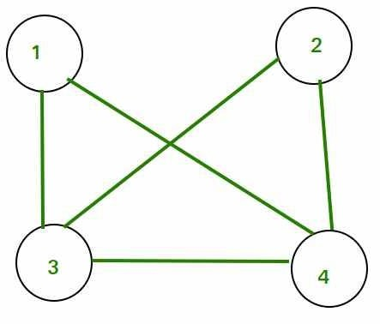
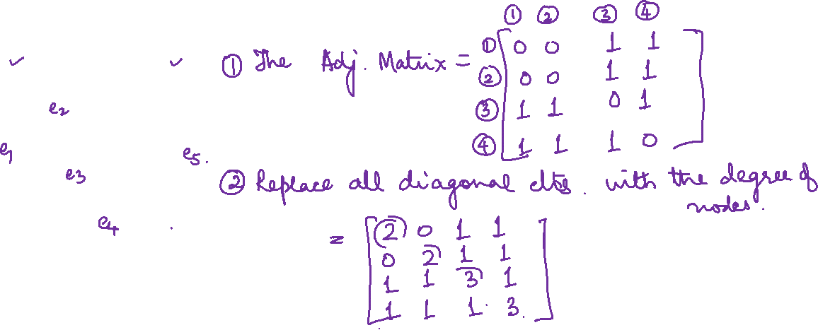
Graph Theory and its Applications Spanning Trees
Consider the following graph which is not complete

Slide 24
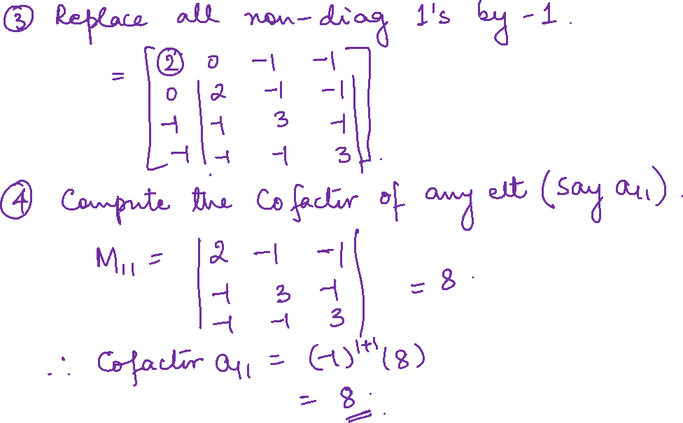

Slide 25
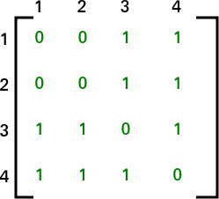
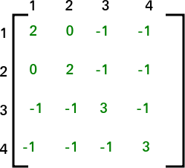
Graph Theory and its Applications Spanning Trees
Cofactor of a_{1,1} = 8.
Hence 8 spanning trees

Slide 26
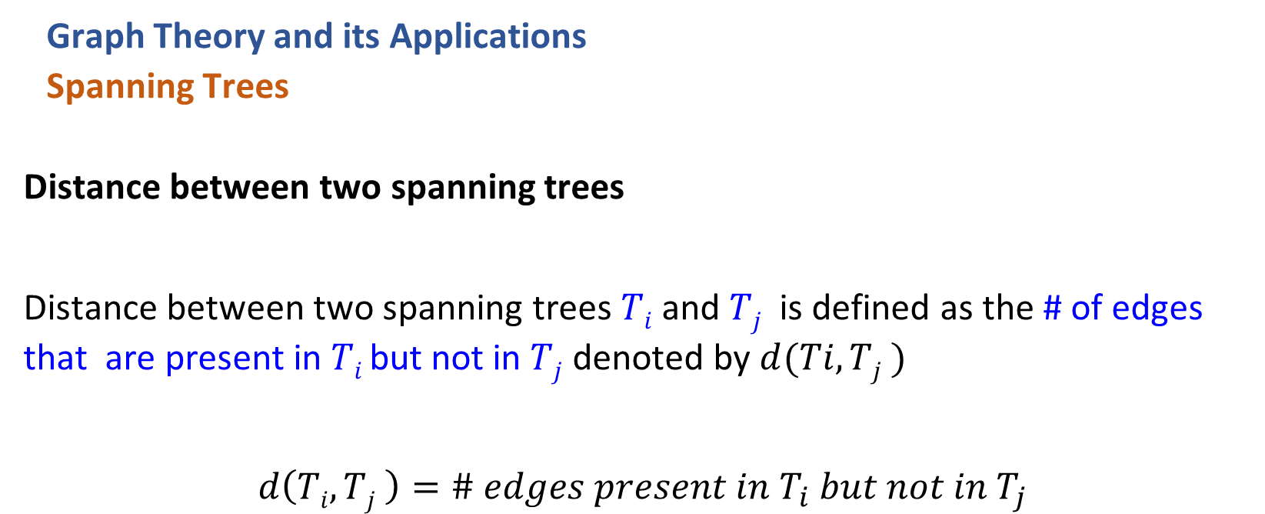
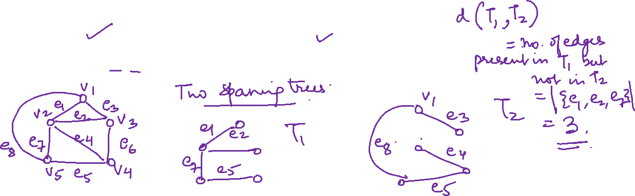
Graph Theory and its Applications
Spanning Trees
Distance between two spanning trees
Distance between two spanning trees $Ti$ and $Tj$ is defined as the # of edges that are present in $Ti$ but not in $Tj$ denoted by $d(Ti, Tj )$
$$d\left(Ti, Tj \right)=\# edges present in T_{i} but not in{ T}_{j}$$

Slide 28

Graph Theory and its Applications
Spanning Trees
Degree Constrained shortest Spanning Tree(DC-SST): is a variation of the spanning tree problem where, in addition to finding a spanning tree that minimizes the total edge weight (i.e., the shortest spanning tree), there is also a constraint on the degree of each vertex in the tree.
Or (A spanning tree whose vertices should not exceed some given maximum degrees and whose total edge length is minimal)
Shortest spanning tree is constrained by max degree of vertices in the tree (k)
Special case is when k=2, the problem reduces to finding the shortest Hamilton path or Travelling Salesman Problem.
Degree Constrained Shortest Path (DCSP) is a NP hard problem

Slide 29
Graph Theory and its Applications
Spanning Trees
Degree Constrained shortest Spanning Tree(DC-SST):
Applications:
Network Design: Ensuring that the degree of nodes (like routers or switches) does not exceed a certain limit to avoid overloading.
Circuit Design: Minimizing the connections in a circuit while ensuring that no component has too many connections.
Power Distribution: Designing a power grid with minimal wiring costs while ensuring that no power station (node) is overloaded with connections.

Slide 30
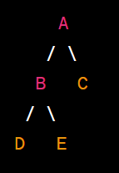

Graph Theory and its Applications
Rooted Trees
A rooted tree is a hierarchical structure in graph theory where each node has a single parent node except for one designated node called the "root," which has no parent.
Each node can have zero or more child nodes.
Rooted trees are used to represent hierarchical relationships and structures, such as family trees, organizational hierarchies, and file directory structures.
The connections between nodes in a rooted tree are directed, meaning they have a specific direction from parent to child.

Slide 31
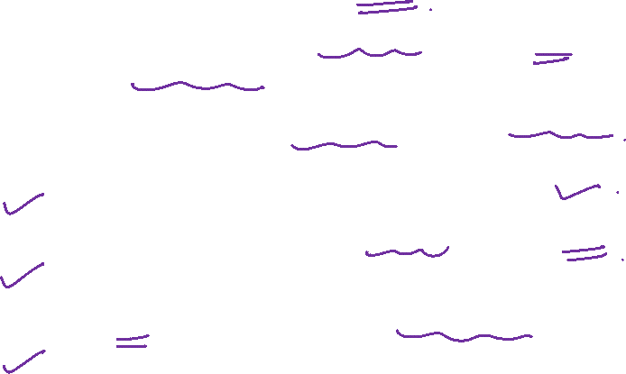
Graph Theory and its Applications
Rooted Trees
A directed tree ‘T’ is called a rooted tree if
Leaves: Leaves are the vertices whose outdegree is zero.
Internal Vertices: They are the non leaf vertices.
Binary Tree: A root tree T is called a binary tree, if every internal vertex
has at most 2 child vertices.
T contains a unique vertex called a root whose in-degree = 0
and the in-degree of all the other vertices =1.

Slide 32
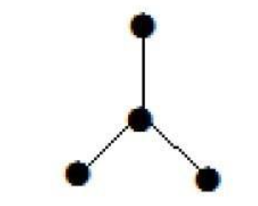

Graph Theory and its Applications
Rooted Trees
Every tree has at least two vertices of degree one.
The vertices ‘a’ and ‘d’ has degree one. And the other two vertices ‘b’ and ‘c’ has degree two.

Slide 33
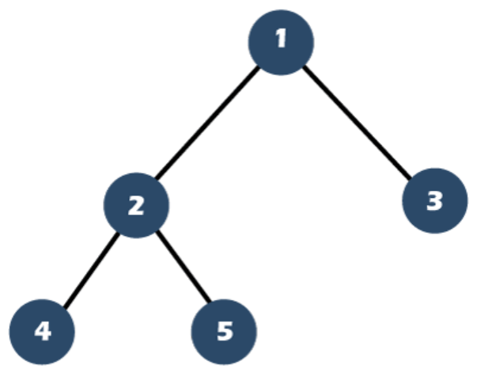
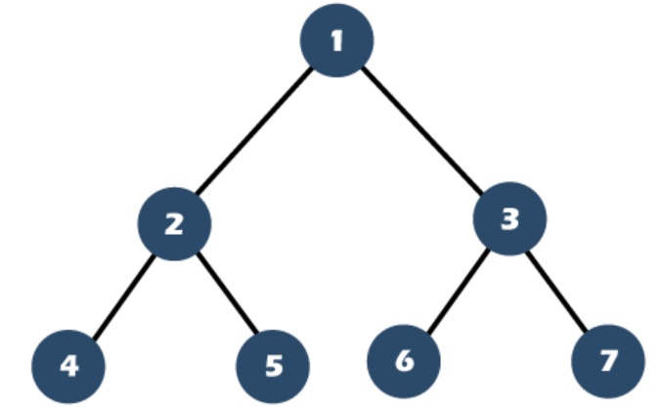

Graph Theory and its Applications Rooted Trees
Full Binary Tree:
A full binary tree can be defined as a binary tree in which all the nodes have 0 or two children.
In other words, the full binary tree can be defined as a binary tree in which all the nodes have two children except the leaf nodes.

Slide 34
Graph Theory and its Applications
Rooted Trees
Full Binary Tree: A complete binary tree is called a full binary tree if all the leaves are at the same level h

Slide 35
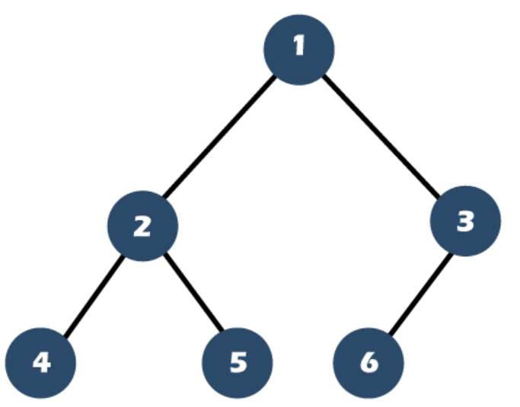
Graph Theory and its Applications Rooted Trees
Complete Binary Tree:
A Binary Tree is a complete Binary Tree if all the levels are completely filled except possibly the last level and the last level has all keys as left as possible.

Slide 36

Graph Theory and its Applications
Rooted Trees
Balanced Tree:
A balanced binary tree, (height-balanced binary tree), is defined as a binary tree in which the height of the left and right subtree of any node differ by not more than 1.
Following conditions are satisfied:
Difference between the left and the right subtree for any node is not more than one
The left subtree is balanced
The right subtree is balanced

Slide 37
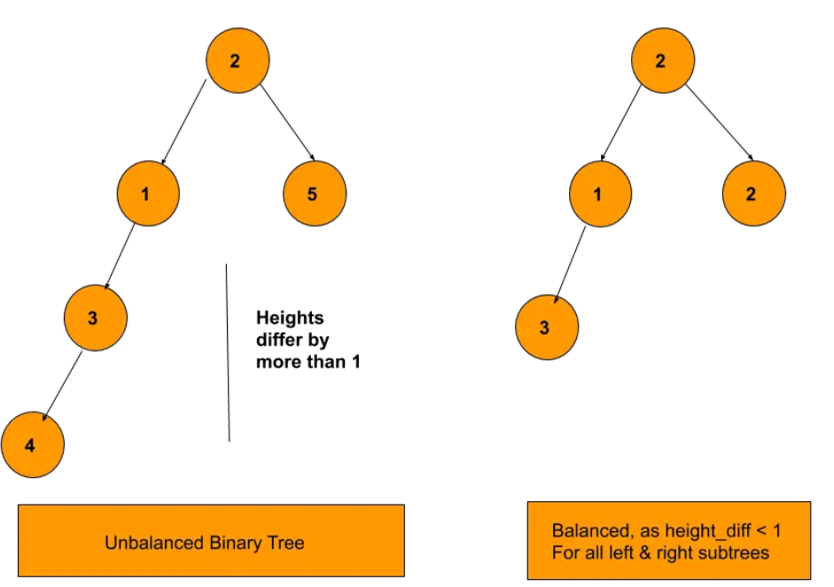
Graph Theory and its Applications
Rooted Trees
Balanced Tree:

Slide 38
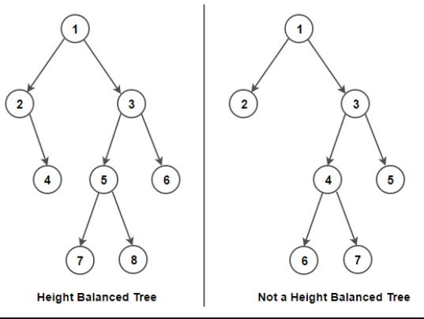
Graph Theory and its Applications
Rooted Trees
Balanced Tree:

Slide 39
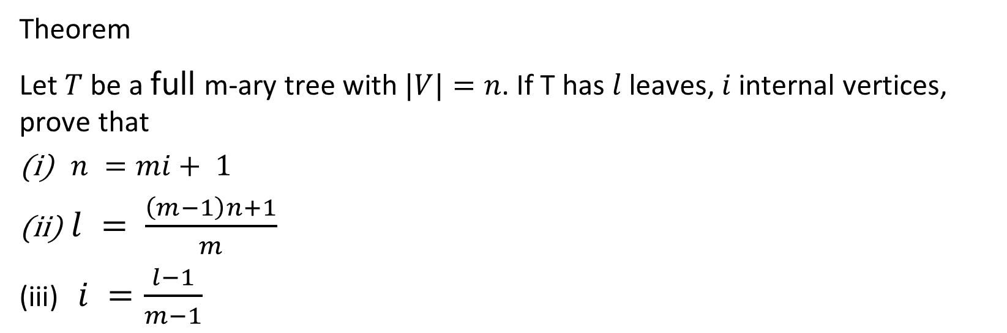
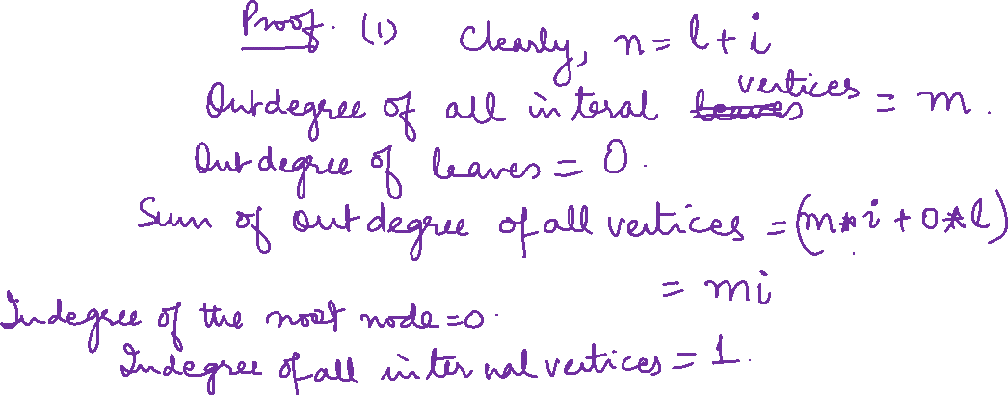
Graph Theory and its Applications Rooted Trees
Theorem
Let $T$ be a full m-ary tree with $|V|=n$. If T has $l$ leaves, $i$ internal vertices, prove that
$n =mi+ 1$
$l = \frac{\left(m−1\right)n+1}{m}$
$i =\frac{l−1}{m−1}$

Slide 40
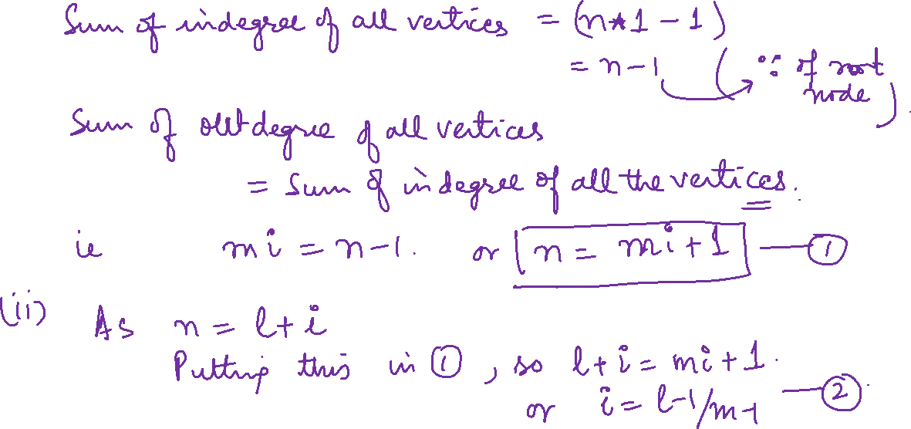

Slide 41
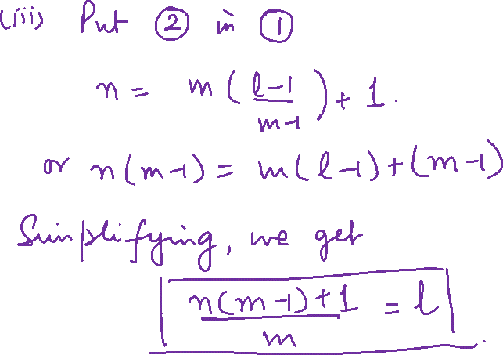

Slide 42
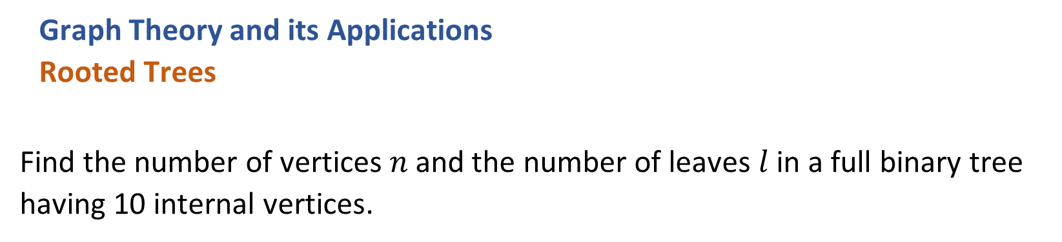
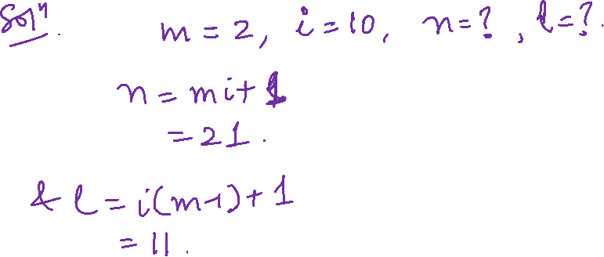
Graph Theory and its Applications
Rooted Trees
Find the number of vertices$n$ and the number of leaves$l$ in a full binary tree having 10 internal vertices.

Slide 43
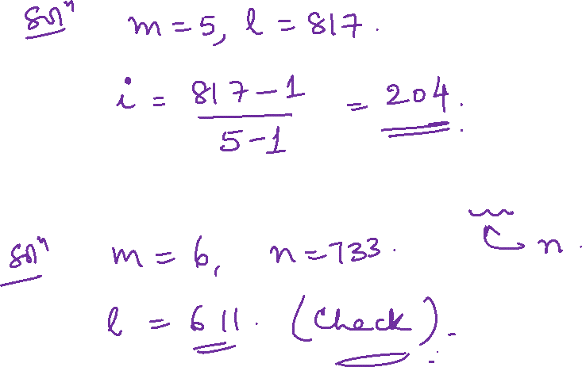
Graph Theory, Applications and Combinatorics Rooted Trees
How many internal vertices does a full 5 – ary tree with 817 leaves have?
How many leaves does a full 6-ary of order 733 have?

Slide 44
THANK YOU
Dr. Arti Arya
Department of Computer Science &Engineering
artiarya@pes.edu

